Slide 1
Loop Parallelism
CS121 Parallel Computing
Spring 2017

Slide 2

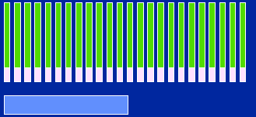
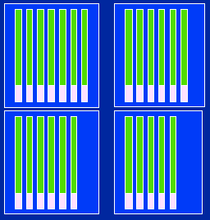
Shared memory algorithm design
Identify
tasks
Original Problem
Group and map onto threads
Tasks, Shared and Private Data
Insert
directives
#pragma omp parallel for
private(j) schedule (static)
for (i = 0; i < n; i++)
for j = 0; j <= i; j++)
a[i,j] = calc(i, j);
Threads, Shared
and Private Data
OpenMP Program

Slide 3
Design considerations
Break program into tasks, consisting of statements that must be executed in order.
Use data dependence analysis.
Map independent tasks to different processors.
Mapping needs to consider load balancing, e.g. static vs dynamic, block vs cyclic work assignment.
Variable specification
Shared vs. private vs. reduction
Shared variables cause cache coherence traffic and much lower performance.
Private and reduction variables don’t need synchronization (except possibly at end of a loop).
Dimension mapping, e.g. row-wise vs column-wise.
Matching mapping to access pattern improves cache locality.

Slide 4
Data dependence analysis
Let S1 and S2 be two statements in a sequential execution of a program.
Suppose S1 occurs before S2. They can have the following dependencies.
S1 →T S2 denotes true dependence (RAW), i.e. S1 writes to a location that is read by S2.
S1 →A S2 denotes anti dependence (WAR), i.e. S1 reads a location written by S2.
S1 →O S2 denotes output dependence (WAW), i.e. S1 writes to the same location written by S2.
Statements that don’t have dependencies are independent.
S1: x = 2;
S2: z = 3;
S3: y = x;
S4: y = x + z;
S5: z = 6;
Dependences
S1 →T S3
S1 →T S4
S3 →O S4
S4 →A S5

Slide 5
Data dependence analysis
When parallelizing a program, must ensure dependent statements run in the same order in the sequential and parallel programs.
Guarantees the parallel and sequential programs behave the same way.
A parallel program may run correctly without satisfying this condition, but it’s not guaranteed.
The ordering requirement is transitive. I.e. if S1 →* S2 and S2 →*S3, then S1 must run before S3 in any parallelization.
Dependent statements cannot on run on different processors, since we can’t enforce the order of execution (interleaving) on different processors.
Independent statements can run on different processors if they haven’t been ordered by transitivity.
Focus on parallelizing loops, since these are common in shared memory programs and are the main performance hotspots.
Notation
Let S denote a statement in the source program.
Given a nested loop with iteration variables i, j, ..., let S[i,j,…] denote a statement in loop iteration [i,j,…].

Slide 6
Loop dependence analysis
Loop-carried dependence
Dependence exists across different iterations of loop.
Loop-independent dependence
Dependence exists within the same iteration of loop.
for (i=1; i<=n; i++) {
S1: a[i] = a[i-1] + 1;
S2: b[i] = a[i];
}
for (i=1; i<=n; i++)
for (j=1; j<=n; j++)
S3: a[i][j] = a[i][j-1] + 1;
for (i=1; i<=n; i++)
for (j=1; j<=n; j++)
S4: a[i][j] = a[i-1][j] + 1;
S1[i] →T S1[i+1]
- loop-carried dependence
S1[i] →T S2[i]
- loop-independent dependence
S3[i,j] →T S3[i,j+1]
loop-carried dependence in j loop
no loop-carried dependence in i loop
S4[i,j] →T S4[i+1,j]
loop-carried dependence in i loop
no loop-carried dependence in j loop

Slide 7
Iteration-space traversal graph
Iteration-space traversal graph (ITG) is a line graph showing the order of traversal in the iteration space.
Node in ITG is a point in the iteration space, i.e. a particular iteration.
Directed edge in ITG gives the next iteration that will be executed after the current iteration.
n = 3
j
for (i=1; i<=n; i++)
for (j=1; j<=n; j++)
S3: a[i][j] = a[i][j-1] + 1;
1
2
3
1
i
2
3

Slide 8
Loop-carried dependence graph
Given the ITG, can determine the dependence between different loops.
Loop-carried Dependence Graph (LDG) shows the loop-carried true/anti/output dependence relationships.
Node in LDG is a point in the iteration space.
Directed edge in LDG is the dependence.
LDG helps identify parts of the loop that can be done in parallel.
n = 3
j
for (i=1; i<=n; i++)
for (j=1; j<=n; j++)
S3: a[i][j] = a[i][j-1] + 1;
1
T
2
3
T
1
S3[i,j] →T S3[i,j+1]
loop-carried dependence in j loop
no loop-carried dependence in i loop
T
T
i
2
T
T
3

Slide 9
Example 1
True dependences
S1[i,j] → T S2[i,j+1]
- loop-carried dependence
Anti dependences
S1[i,j] → A S2[i,j]
loop-independent
dependence
Output dependences
None
for (i=1; i<=n; i++)
for (j=1; j<=n; j++) {
S1: a[i][j] = b[i][j] + c[i][j];
S2: b[i][j] = a[i][j-1] * d[i][j];
}
ITG
LDG
n = 3
j
n = 3
j
1
2
3
1
2
3
T
T
1
1
T
T
i
2
i
2
T
T
3
3

Slide 10
Example 1
Task Identification
n parallel tasks - one task per iteration of i loop.
Grouping / mapping
Static block as different iterations have same work.
OpenMP
#pragma omp parallel for private(j) schedule(static)
for (i=1; i<=n; i++)
for (j=1; j<=n; j++) {
S1: a[i][j] = b[i][j] + c[i][j];
S2: b[i][j] = a[i][j-1] * d[i][j];
}

Slide 11
Example 2
True dependences
S1[i] → T S1[i+2]
- loop-carried dependence
Anti dependences
None
Output dependences
None
for (i=1; i<=n; i++)
S1: a[i] = a[i-2];
i
1
2
3
4
5
ITG
i
T
T
1
2
3
4
5
LDG
T
T

Slide 12
Example 2
Task Identification
There are opportunities when some dependences are missing.
Can divide the for loop into two parallel tasks, one with even iterations and another with odd iterations.
Grouping / mapping
One task per thread
OpenMP
#pragma omp parallel sections
private(i)
{
#pragma omp section
for (i=1; i<=n; i+=2)
a[i] = a[i-2];
#pragma omp section
for (i=2; i<=n; i+=2)
a[i] = a[i-2];
}

Slide 13
Example 3
True dependences
S1[i] → T S1[i+1]
- loop-carried dependence
Anti dependences
None
Output dependences
None
for (i=1; i<=n; i++)
S1: a[i] = a[i-1] + b[i]*c[i] + d[i];
i
1
2
3
4
5
ITG
i
1
2
3
4
5
LDG
T
T
T
T
Must respect loop-carried dependence

Slide 14
Example 3
Task Identification
Any opportunities for parallelism? Loop-carried dependence S[i] →T S[i+1] must be respected.
But no loop-carried dependence in b[i]*c[i]+d[i] part.
Loop fission
Distribute into two separate loops .
Code after loop fission
for (i=1; i<=n; i++) {
S1: temp[i] = b[i]*c[i] + d[i];
}
for (i=1; i<=n; i++) {
S2: a[i] = a[i-1] + temp[i];
}
No dependences in first loop, so can be parallelized.
In second loop
True dependences:
S2[i] → T S2[i+1]
loop-carried dependence
Anti dependences None
Output dependences None

Slide 15
Example 3
OpenMP
Note array temp[] introduces storage overhead.
Better OpenMP solution
ordered statement enforces a[i] assignment ordering.
With k threads, uses k extra storage.
Typically k << n so we save space.
#pragma omp parallel for schedule(static)
for (i=1; i<=n; i++) {
temp[i] = b[i]*c[i] + d[i];
}
for (i=1; i<=n; i++) {
a[i] = a[i-1] + temp[i];
}
#pragma omp parallel for ordered private(t) schedule(static)
for (i=1; i<=n; i++) {
t = b[i]*c[i] + d[i]; /* one copy of t per thread */
#pragma omp ordered
a[i] = a[i-1] + t; }

Slide 16
Example 4
True dependences
S1[i] →T S3[i]
loop-independent dependence
S4[i] →T S4[i+1]
loop-carried dependence
Anti dependences
S1[i] →A S2[i+1]
loop-carried dependence
Output dependences None
for (i=1; i<=n; i++) {
S1: a[i] = b[i+1]*a[i];
S2: b[i] = b[i]*coef;
S3: c[i] = 0.5*(c[i] + a[i]);
S4: d[i] = d[i-1] + d[i];
}
i
1
2
3
4
5
ITG
i
1
2
3
4
5
T
T
T
T
LDG
Must respect loop-carried dependence

Slide 17
Example 4
Task Identification
S4 has no dependences with other statements, so can distribute into two separate loops (loop fission).
This gives two parallel tasks, a loop containing S1, S2 and S3 and a loop containing S4.
OpenMP
#pragma omp parallel sections
private(i)
{
#pragma omp section
for (i=0; i<=n; i++) {
S1: a[i] = b[i+1]*a[i];
S2: b[i] = b[i]*coef;
S3: c[i] = 0.5*(c[i] + a[i]);
}
#pragma omp section
for (i=0; i<n; i++) {
S4: d[i] = d[i-1] + d[i];
}
}

Slide 18
Distance and direction vectors
Let T₁ and T₂ be iterations s.t. T₁ →* T₂.
Distance vector from T₁ to T₂ is T₂ – T₁.
Direction vector from T₁ to T₂ is sign(T₂ – T₁).
for (i=1; i<=n; i++) {
for (j=1; j<=n; j++) {
A[i,j] = A[i-1,j+2] – 1;
}}
Iteration (i,j) depends on iteration (i-1, j+2).
Distance vector is (1, -2).
Direction vector is (+, -)
for (i=1; i<=n; i++) {
for (j=1; j<=n; j++) {
A[i,j] = A[i-1,j] + A[i,j-1];
}}
Iteration (i,j) depends on iterations (i-1, j) and (i,j-1).
Distance vectors are (1,0) and (0,1).
Direction vectors (+, 0) and (0, +).

Slide 19
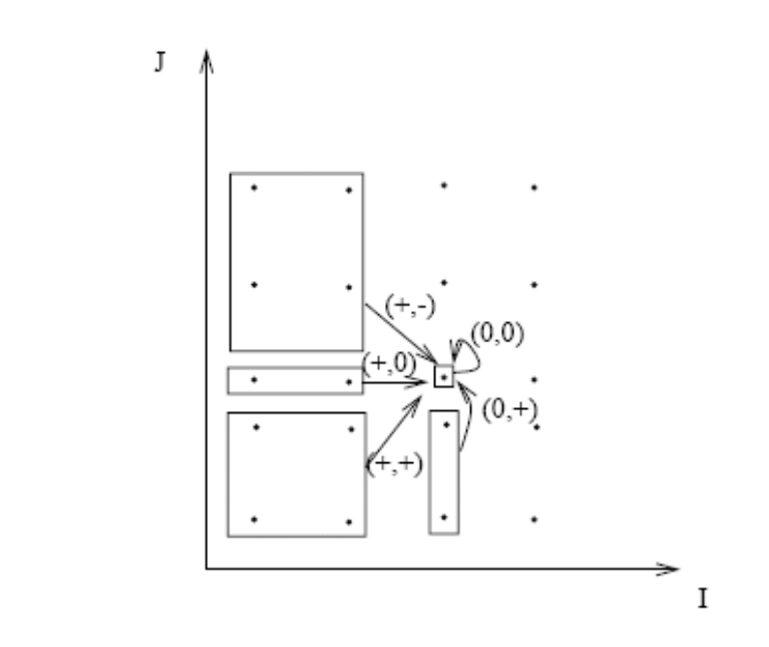
Legal direction vectors
Consider a nested loop over (i,j) (j is the inner loop).
The following direction vectors are possible
(+,+), (+,0), (+,-), (0,+), (0,0).
Ex A[i,j] = A[i-1, j+1] has direction vector (+,-).
Ex A[i,j] = A[i,j] + 1 has direction vector (0,0).
The following directions are not possible.
(0,-), (-,+), (-,0), (-,-).
Ex A[i,j] = A[i+1, j-1] has direction vector (-,+), but this isn’t a legal statement since iteration (i+1,j-1) happens after (i, j).

Slide 20
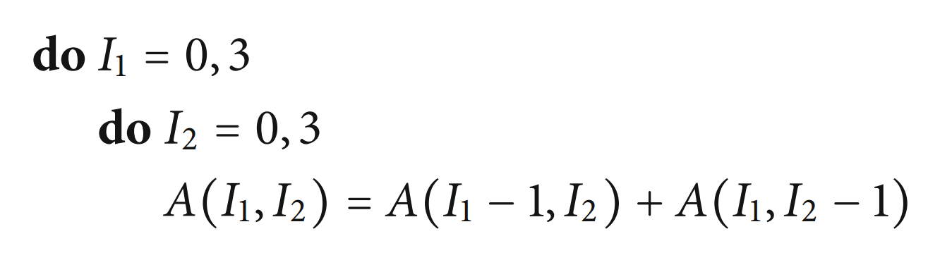
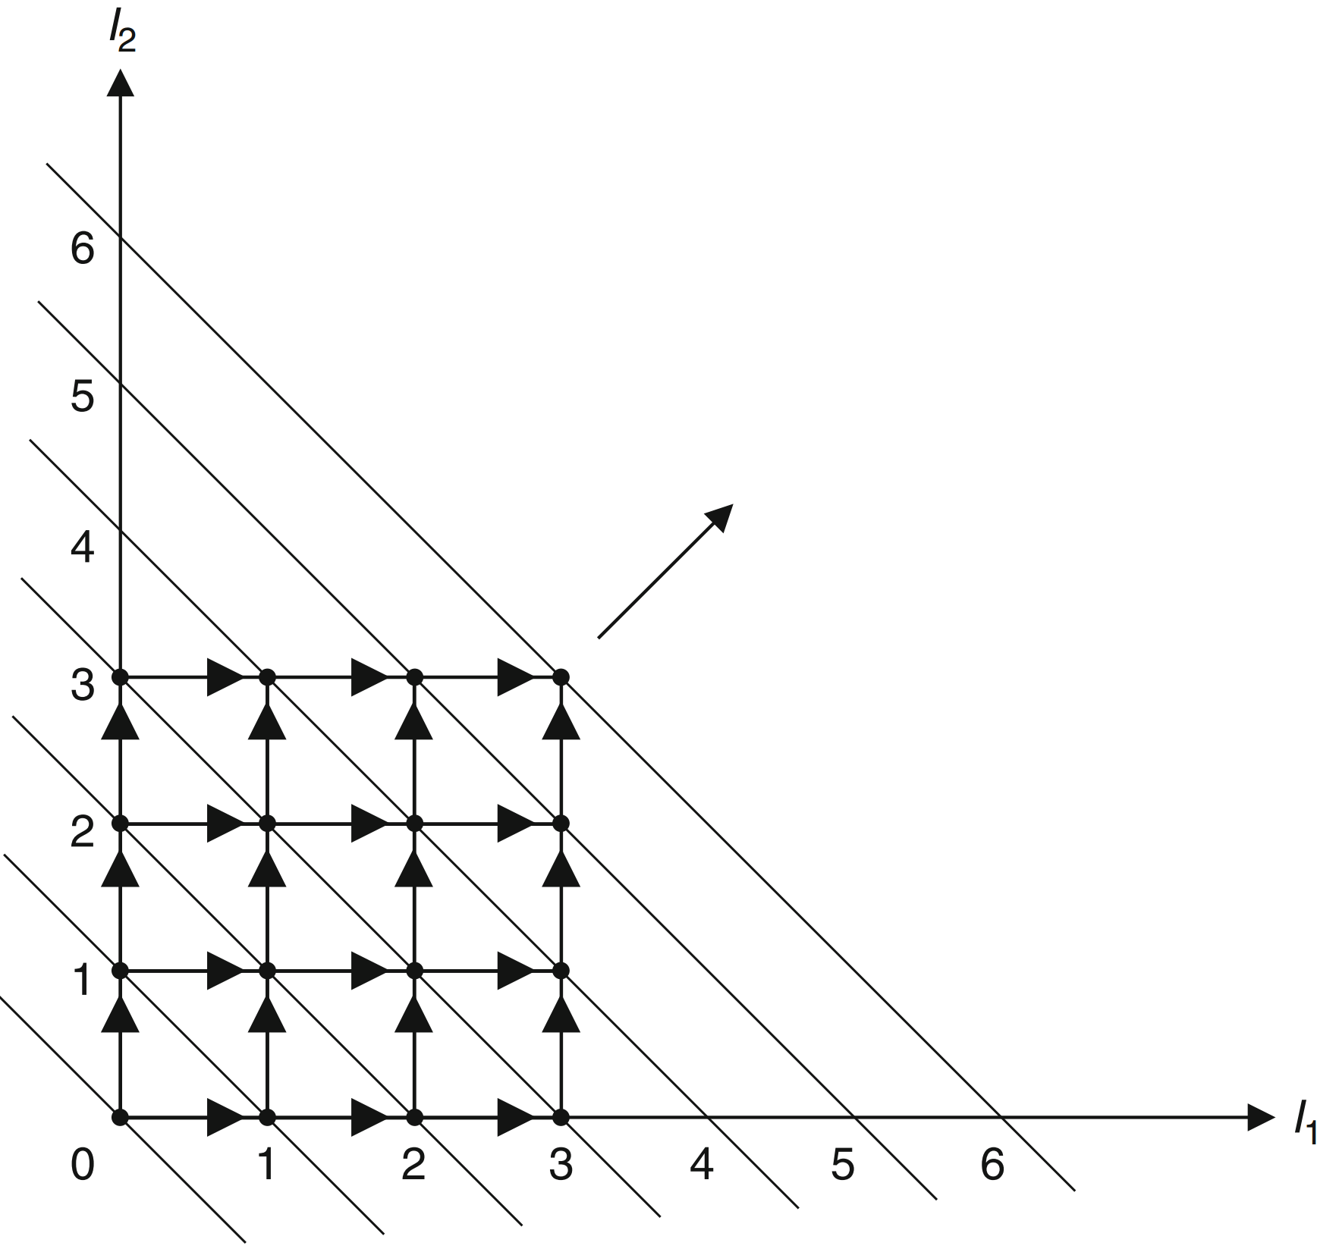
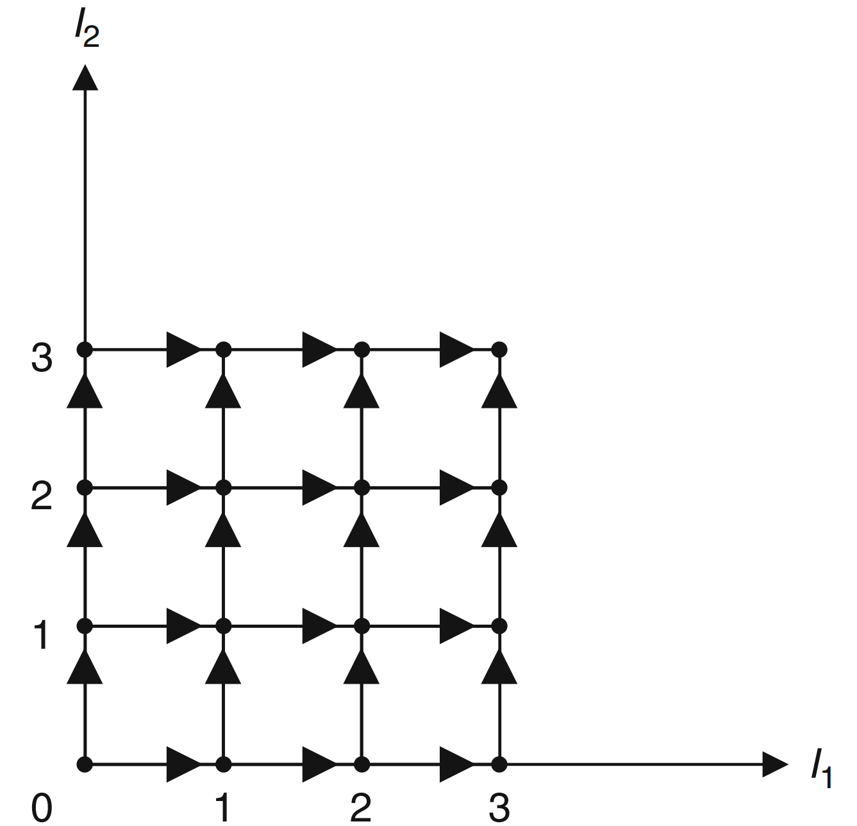
Loop skewing
If a loop has dependencies that prevent it being parallelized, we can try to transform (skew) the loop indices to create parallelizable loops.
Ex Create new loop indices, the outer loop across the diagonal lines, the inner loop along the diagonal lines.
Inner loop iterations can be done in parallel.
Source: Unimodular Transformations, Utpal Banerjee

Slide 21
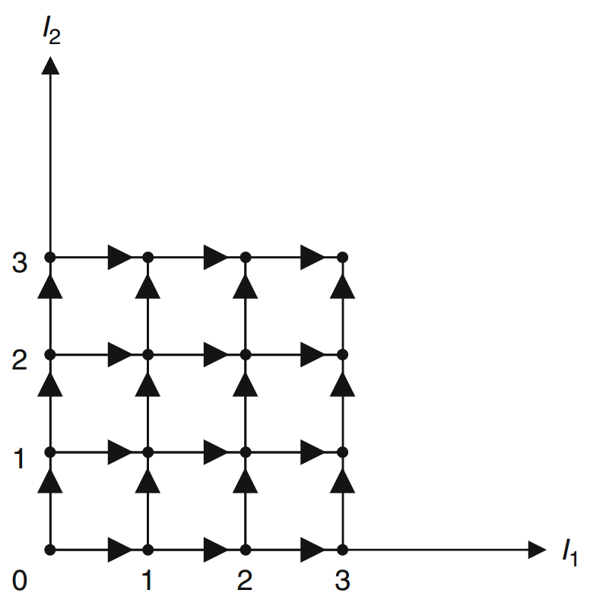
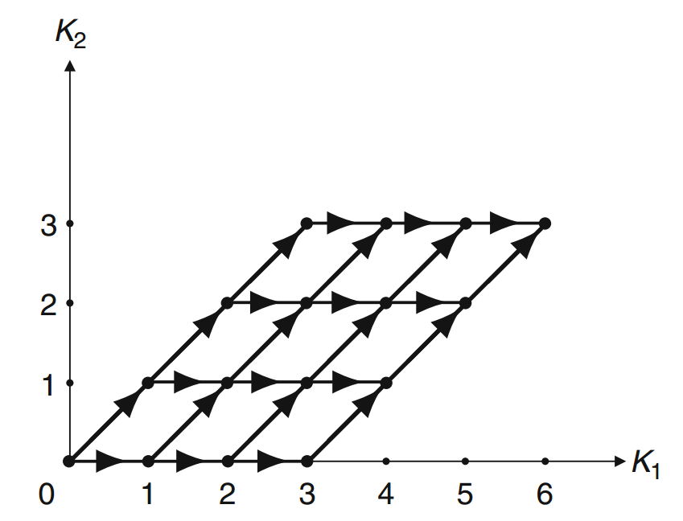
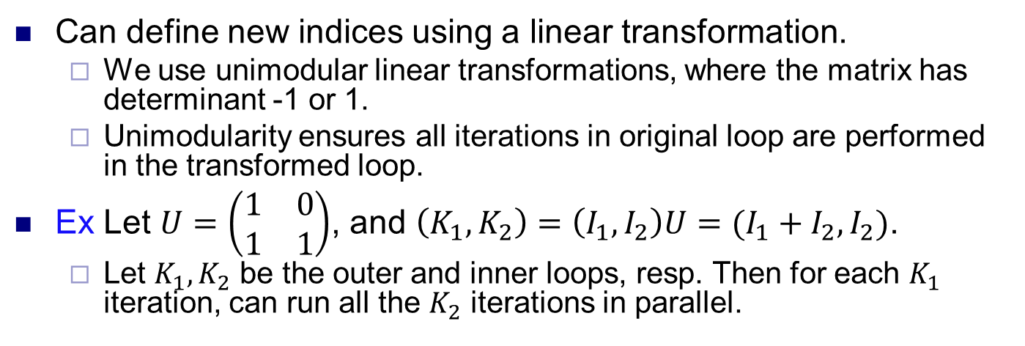
Unimodular transformations
Can define new indices using a linear transformation.
We use unimodular linear transformations, where the matrix has determinant -1 or 1.
Unimodularity ensures all iterations in original loop are performed in the transformed loop.
Ex Let $U=\left(\begin{matrix}1 & 0 \\ 1 & 1\end{matrix}\right)$, and $\left(K_{1},K_{2}\right)=\left(I_{1},I_{2}\right)U=(I_{1}+I_{2}, I_{2})$.
Let $K_{1}, K_{2}$ be the outer and inner loops, resp. Then for each $K_{1}$ iteration, can run all the $K_{2}$ iterations in parallel.

Slide 22
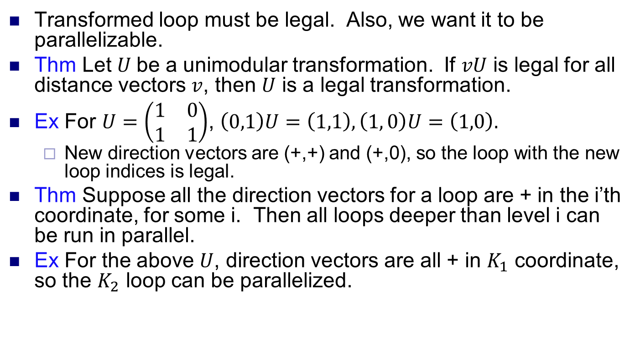
Extracting parallelism
Transformed loop must be legal. Also, we want it to be parallelizable.
Thm Let $U$be a unimodular transformation. If $vU$ is legal for all distance vectors $v$, then $U$ is a legal transformation.
Ex For $U=\left(\begin{matrix}1 & 0 \\ 1 & 1\end{matrix}\right)$, $\left(0,1\right)U=\left(1,1\right), \left(1, 0\right)U=\left(1,0\right).$
New direction vectors are (+,+) and (+,0), so the loop with the new loop indices is legal.
Thm Suppose all the direction vectors for a loop are + in the i’th coordinate, for some i. Then all loops deeper than level i can be run in parallel.
Ex For the above $U$, direction vectors are all + in $K_{1}$ coordinate, so the $K_{2}$ loop can be parallelized.
A[I₁,I₂] = A[I₁-1,I₂] + A[I₁,I₂-1]
A[K₁,K₂] = A[K₁-1,K₂-1] + A[K₁-1,K₂]

Slide 23
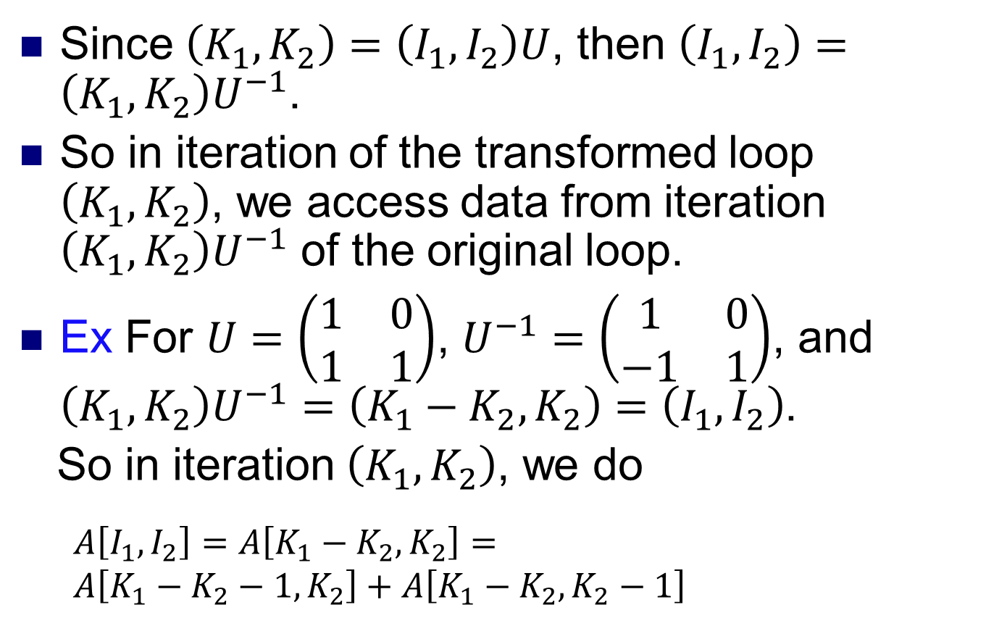
Data accesses after skewing
Since $\left(K_{1},K_{2}\right)=\left(I_{1},I_{2}\right)U$, then $\left(I_{1},I_{2}\right)=\left(K_{1},K_{2}\right)U^{−1}$.
So in iteration of the transformed loop $\left(K_{1},K_{2}\right)$, we access data from iteration $\left(K_{1},K_{2}\right)U^{−1}$ of the original loop.
Ex For $U=\left(\begin{matrix}1 & 0 \\ 1 & 1\end{matrix}\right)$, $U^{−1}=\left(\begin{matrix}1 & 0 \\ −1 & 1\end{matrix}\right)$, and $\left(K_{1},K_{2}\right)U^{−1}=\left(K_{1}−K_{2},K_{2}\right)=\left(I_{1},I_{2}\right)$.
So in iteration $\left(K_{1},K_{2}\right)$, we do
$$A\left[I_{1},I_{2}\right]=A\left[K_{1}−K_{2},K_{2}\right]=$$
$$A\left[K_{1}−K_{2}−1,K_{2}\right]+A\left[K_{1}−K_{2},K_{2}−1\right]$$

Slide 24
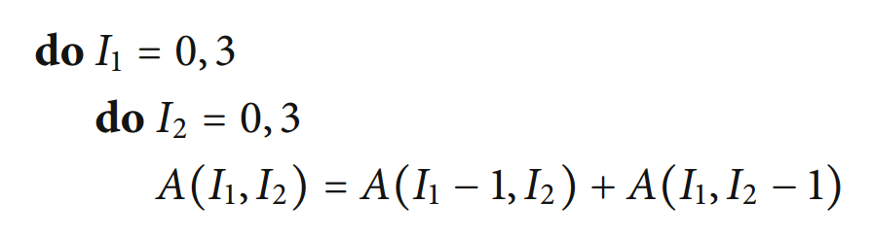
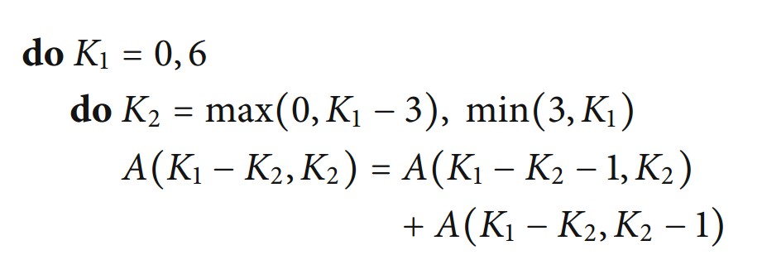
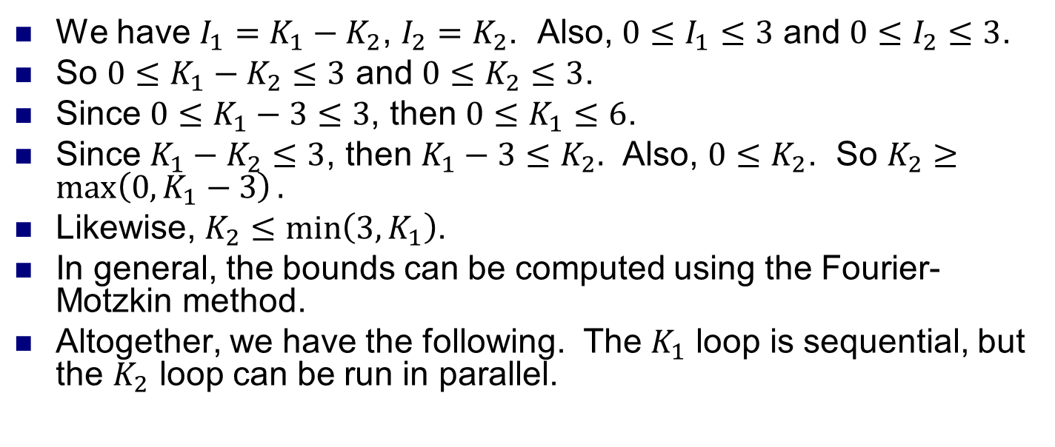
Loop bounds after skewing
We have $I_{1}=K_{1}−K_{2}$, $I_{2}=K_{2}$. Also, $0≤I_{1}≤3$ and $0≤I_{2}≤3$.
So $0≤K_{1}−K_{2}≤3$ and $0≤K_{2}≤3$.
Since $0≤K_{1}−3≤3$, then $0≤K_{1}≤6$.
Since $K_{1}−K_{2}≤3$, then $K_{1}−3≤K_{2}.$ Also, $0≤K_{2}$. So $K_{2}≥\max\left(0, K_{1}−3\right).$
Likewise, $K_{2}≤\min\left(3, K_{1}\right)$.
In general, the bounds can be computed using the Fourier-Motzkin method.
Altogether, we have the following. The $K_{1}$ loop is sequential, but the $K_{2}$ loop can be run in parallel.

Slide 25
Algorithmic analysis
Sometimes there is no way to restructure a loop to increase parallelism.
We can try to restructure the algorithm to eliminate dependences and improve parallelism.
Need to understand the purpose of the algorithm and how it is used.
For example, some algorithms are nondeterministic or calculate an approximation (e.g., Jacobi iteration).
In this case, restructuring the algorithm or ignoring some dependences may still give a valid result.

Slide 26
Fibonacci numbers
Fibonacci numbers
F₁=F₂=1.
F_{n}=F_{n-1}+F_{n-2}, for n>2.
1,1,2,3,5,8,13,21,34,...
Computing F_{n} sequentially takes O(n) time.
Can we compute F_{n} in parallel?
Looking at the LDG, it seems there’s no parallelism available.
0
1
2
3
4

Slide 27
Fibonacci numbers in parallel
*
A simple identity.
Let A=
By repeatedly applying the identity, we get
So if we can quickly compute A^{n} in parallel, we can compute F_{n+2}.
Can compute F_{n} in O(log n) time with n processors.
*
*
*
*
*
*
A
A
A
A
A
A
A
A
p₁
p₂
p₃
p₄
p₅
p₆
p₇
p₈

